Slide 1

Artificial evolution of ANT
By: Tanishq and Aman

Slide 2
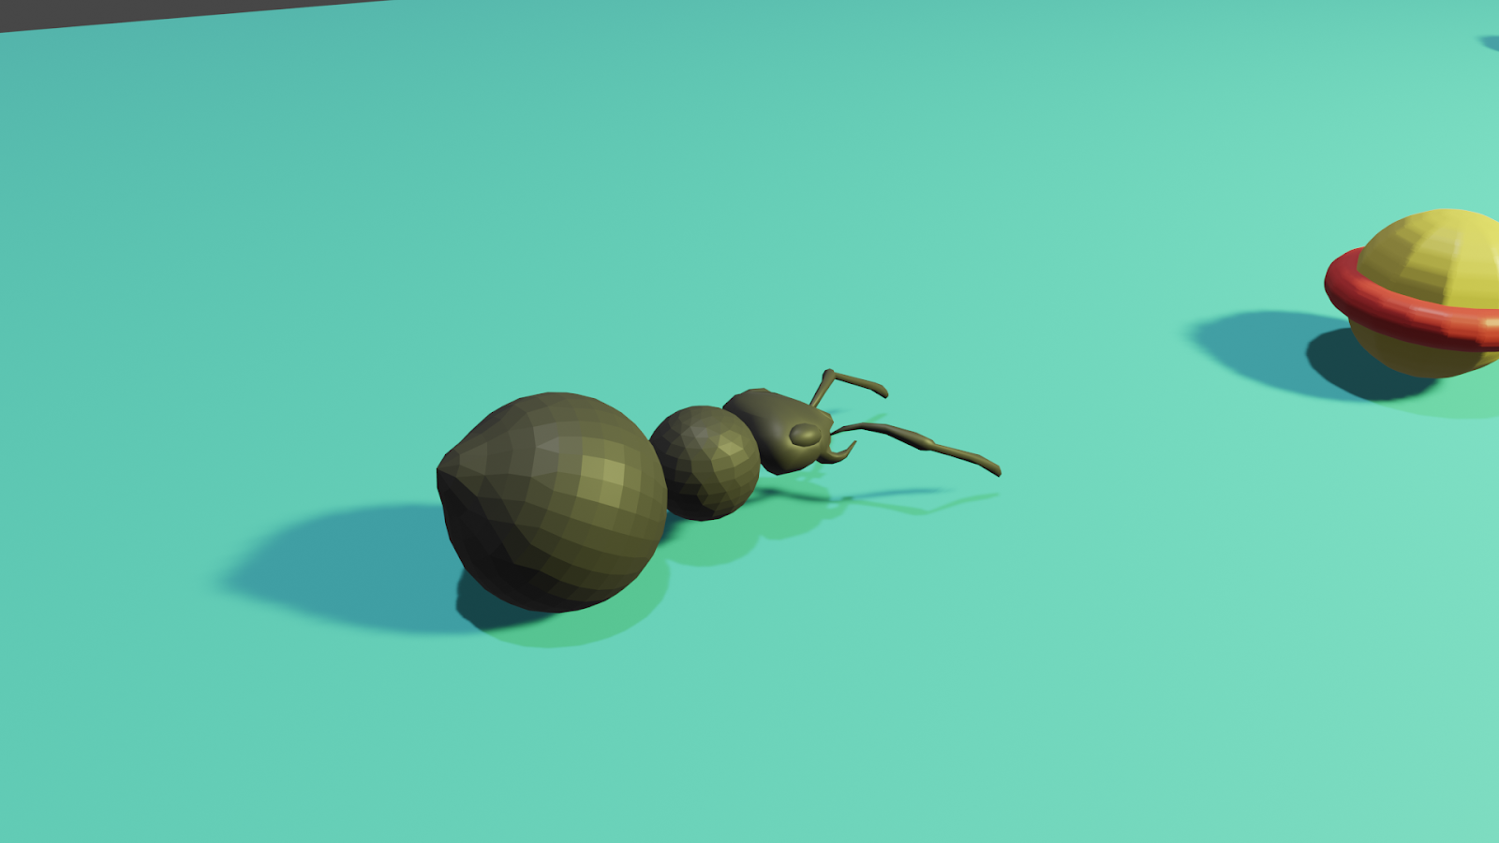
PROJECT OVERVIEW
Nature is full of miracles, just a little genetic shift can promote the inception of a new species. In this new era of artificial intelligence, we are keen to replicate it on artificial species to thrive in their artificial environment.
Ant is a small yet complex creature on earth, different species have different traits and they possess some of the most complex behaviour due to natural selection and survival of the fittest.
In our artificial earth, we want to produce complex behaviour in ants with the help of artificial intelligence.
Algorithms used for artificial earth:
Genetic Algorithm
Artificial Neural Network

Slide 3
Project Description
Single Ant Interaction and Evolution
In our artificial environment, there is a single ant. The ant's motive is to eat food which is present in the environment.

Slide 4
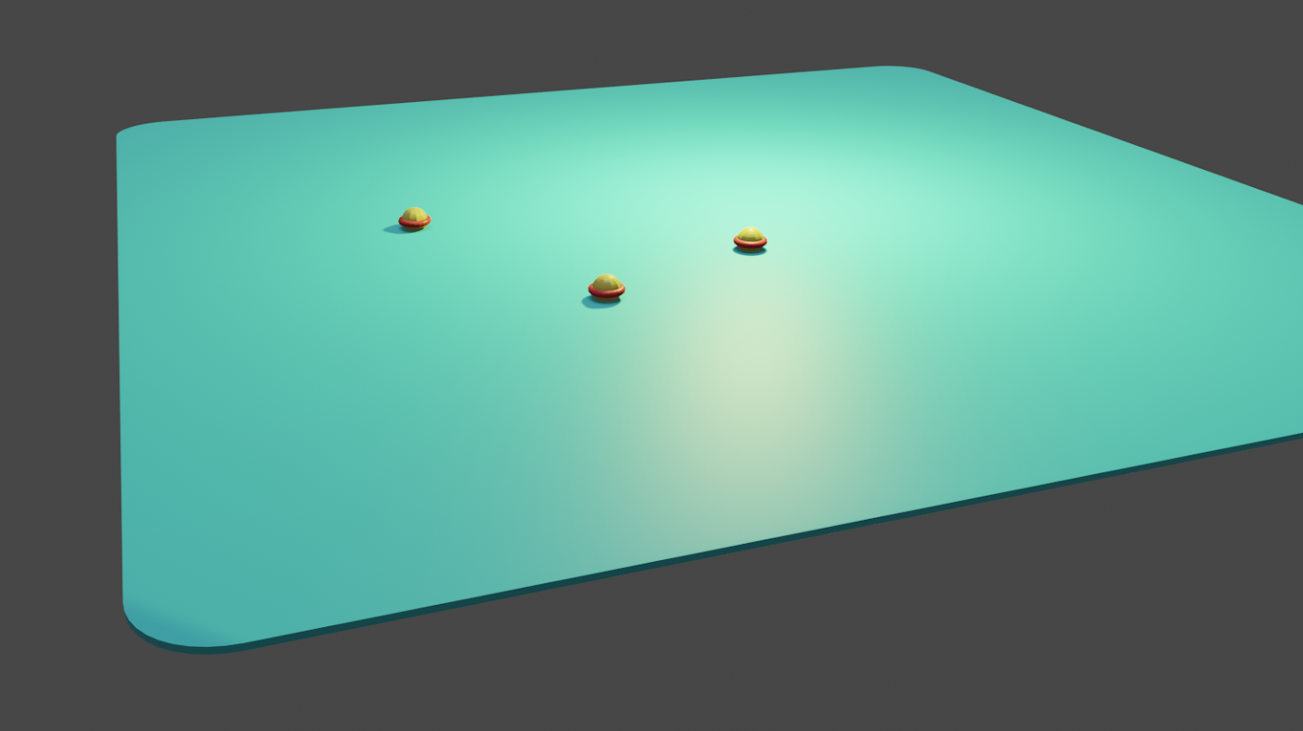
Environment
The artificial environment consists of a grid of 20 x 20. The ant can't go out of the grid. The environment provides food on the grid, the ant has to eat the food to survive.

Slide 5
ANT
The ant resides in the grid in the environment. The ant can move in three directions - left, right and front. The ant can roam freely in the environment, the constraint for the ant is that if it goes out of board it will die.

Slide 6
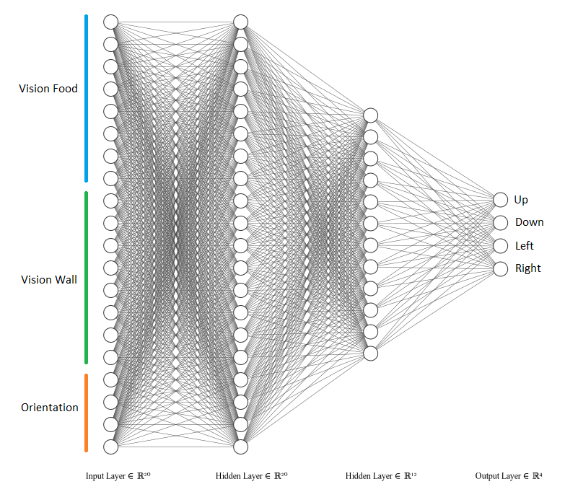
Neural Network Architecture

Slide 7
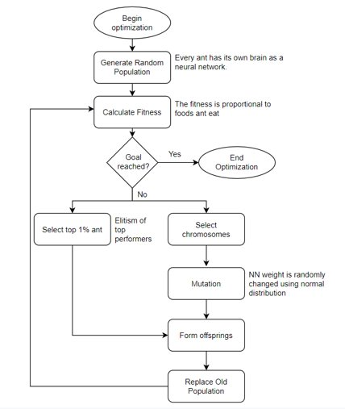
FLOW CHART

Slide 8
Algorithm
Initialize 100 ants having brain as Neural Network.(Each Neural Network has two hidden layer with 20 Neurons in first layer and 12 neurons in second layer.
Put the ant in a grid in the environment, let it move according to the decisions made by neural network(brain)
Calculate fitness according to the food eaten by it.
If Goal reached then End the optimization Else goto 5.
Select top one per cent ant and add to new population array.
Select chromosomes randomly from top 50 per cent parent then mutate it using normal distribution.
Merge the array in 5 and 6 to make a new population array.
Repeat from 2 to 7.

Slide 9
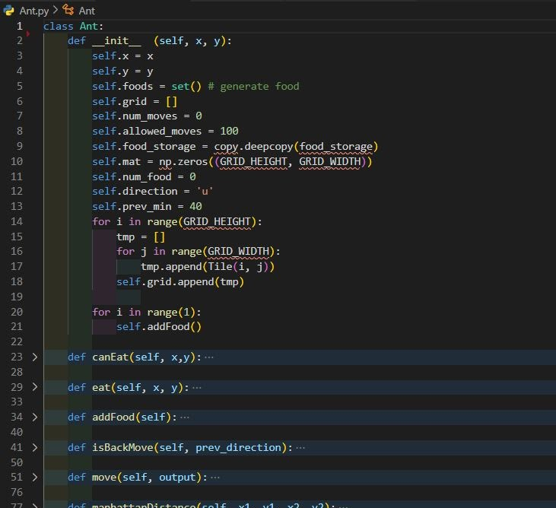
ANT Class

Slide 10
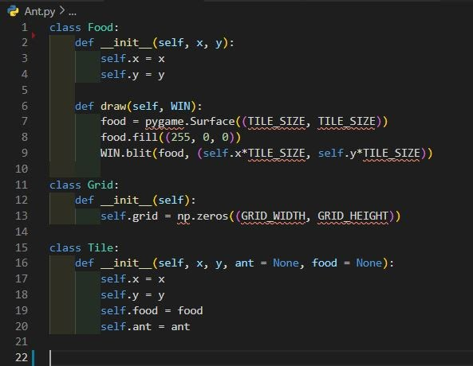
ENVIRONMENT COMPONENTS CLASSES

Slide 11
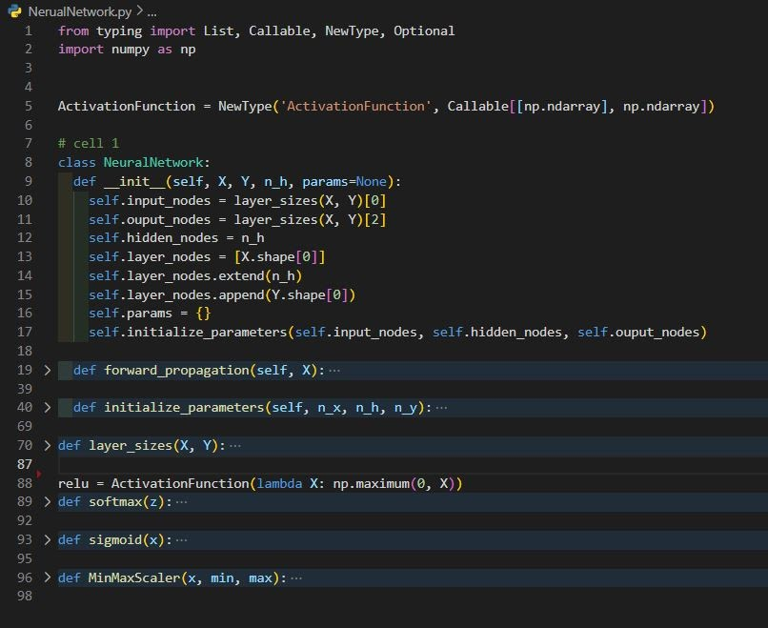
NEURAL NETWORK IMPLEMENTATION

Slide 12
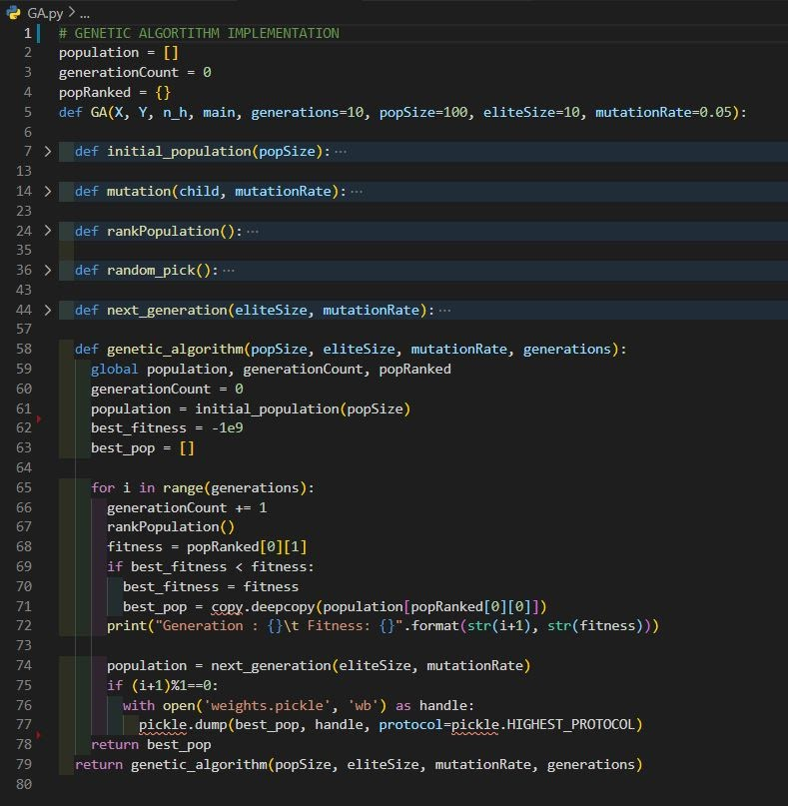
Genetic algorithm implementation

Slide 13
DEMONSTRATION
Generation 0
01
Generation 10
02
Generation 50
03
Generation 100
04
Generation 500
05
Generation 800
06
Generation 1190
07

Slide 14
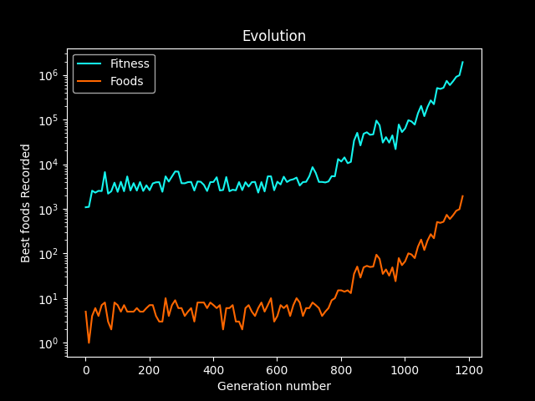
RESULT AND ANALYSIS
In our experimental investigations, we have successfully trained the brain (ANN) of ant to get the highest fitness value as 45592083. The maximum food eaten by the ant is 45596.
Our trial is based on running the genetic algorithm to 1190 generations after which we have got the best fitness value.

Slide 15
LIMITATIONS
Geometry
More complex Environment
Ants complex behavior
Slow training rate of Genetic Algorithm

Slide 16
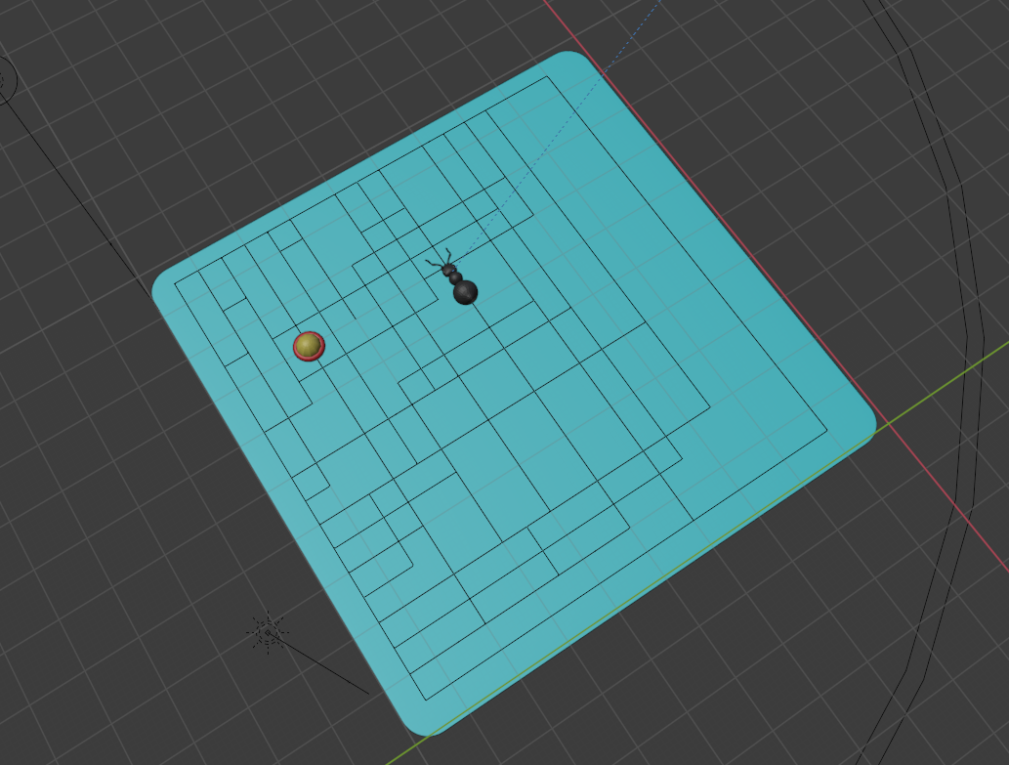
LIMITATION

Slide 17
FUTURE WORK
In our model we have taken a single ant to learn the direction it needs to go to get the food, the next goal is to make an artificial environment of multiple ants to interact with each other and the environment to learn some complex behaviour like teamwork, self-organizing, ant colony building, dead reckoning. For training, we have used a genetic algorithm and it has slow learning due to its brute force nature, so for learning reinforcement learning can be used to optimize.

Slide 18

THANK YOU

